Slide 1
Shortest Paths Algorithms Exercises ANS
BFS
Dijkstra’s Algorithm
Bellman-Ford Algorithm
Lectures 5-6, Spring 2026
Notes:
Welcome to week 2
Finally, we get to build a routing protocol. Today will be entirely focused on Distance-Vector approach and then we’ll talk about an alternative approach hopefully tomorrow.
so we're going to number them 1 through seven we'll come up with rules and when you put the seven rules together you get
29:30
an algorithm called the distance Vector protocol and it allows us to find shortest paths through the entire
29:36
network

Slide 2
Q. Dijkstra’s Algorithm
Given this directed graph, run Dijkstra’s Algo to find shortest paths starting from source node A. Give the node visit order, and fill in this table of SN (Shortest Distance) and PN (Previous Node), crossing out old SD and PN as you find a shortcut path with smaller SD
Visit Order
Node | SD | PN
A
B
C
D
E
F
G
start
2
B
A
1
1
5
2
E
1
1
D
C
5
3
2
6
G
10
F

Slide 3
Q. Dijkstra’s Algorithm
0
∞
start
2
B
A
1
1
∞
2
5
E
∞
1
∞
1
D
C
5
3
∞
2
6
G
Node | SD | PN
A | ∞
B | ∞
C | ∞
D | ∞
E | ∞
F | ∞
G | ∞
∞
10
F
Visit Order
Notes:
Can print this on the worksheet

Slide 4
Q. Dijkstra’s Algorithm
0
∞
start
2
B
A
1
1
∞
2
5
E
1??
1
2??
1
D
C
5
3
∞
2
6
G
Node | SD | PN
A | 0 | /
B | ∞
C | 2 | A
D | 1 | A
E | ∞
F | ∞
G | ∞
∞
10
F
Visit Order
A

Slide 5
Q. Dijkstra’s Algorithm
0
6??
start
2
B
A
1
1
2??
2
5
E
1
1
2??
1
D
C
5
3
6??
2
6
G
Node | SD | PN
A | 0 | /
B | 6 | D
C | 2 | A
D | 1 | A
E | 2 | D
F | 7 | D
G | 6 | D
7??
10
F
Visit Order
A, D
We can choose to visit either C or E next, since they have equal smallest SD of 2 among all unvisited nodes. Let’s visit C in alphabetical order

Slide 6
Q. Dijkstra’s Algorithm
0
6??
start
2
B
A
1
1
2??
2
5
E
1
1
2
1
D
C
5
3
6??
2
6
G
Node | SD | PN
A | 0 | /
B | 6 | D
C | 2 | A
D | 1 | A
E | 2 | D
F | 7 4 | D C
G | 6 | D
4??
10
F
Visit Order
A, D, C

Slide 7
Q. Dijkstra’s Algorithm
0
3??
start
2
B
A
1
1
2
2
5
E
1
1
2
1
D
C
5
3
6??
2
6
G
Node | SD | PN
A | 0 | /
B | 6 3 | D E
C | 2 | A
D | 1 | A
E | 2 | D
F | 7 4 | D C
G | 6 | D
4??
10
F
Visit Order
A, D, C, E

Slide 8
Q. Dijkstra’s Algorithm
0
3
start
2
B
A
1
1
2
2
5
E
1
1
2
1
D
C
5
3
6??
2
6
G
Node | SD | PN
A | 0 | /
B | 6 3 | D E
C | 2 | A
D | 1 | A
E | 2 | D
F | 7 4 | D C
G | 6 | D
4??
10
F
Visit Order
A, D, C, E, B

Slide 9
Q. Dijkstra’s Algorithm
0
3
start
2
B
A
1
1
2
2
5
E
1
1
2
1
D
C
5
3
6??
2
6
G
Node | SD | PN
A | 0 | /
B | 6 3 | D E
C | 2 | A
D | 1 | A
E | 2 | D
F | 7 4 | D C
G | 6 | D
4
10
F
Visit Order
A, D, C, E, B, F

Slide 10
Q. Dijkstra’s Algorithm ANS
0
3
start
2
B
A
1
1
2
2
5
E
1
1
2
1
D
C
5
3
6
2
6
G
Node | SD | PN
A | 0 | /
B | 6 3 | D E
C | 2 | A
D | 1 | A
E | 2 | D
F | 7 4 | D C
G | 6 | D
4
10
F
Visit Order
A, D, C, E, B, F, G

Slide 11
Q. Dijkstra’s Algorithm (Source Node S)
ANS
ANS
A
A
2
Node | SD | PN
S | 0 | /
A
B
2
Node | SD | PN
S | 0 | /
A
B
S
S
1
3
4
4
B
B
ANS
ANS
A
A
Node | SD | PN
S | 0 | /
A
B
2
Node | SD | PN
S | 0 | /
A
B
2
S
S
1
1
4
4
B
B
11
Notes:
SD: Shortest Distance. PN: Previous Node

Slide 12
Q. Dijkstra’s Algorithm (Source Node S) ANS
ANS
ANS
A
A
2
Node | SD | PN
S | 0 | /
A | 2 | S
B | 4 3 | S A
2
Node | SD | PN
S | 0 | /
A | 2 | S
B | 4 | S
S
S
1
3
4
4
B
B
ANS
ANS
A
A
Node | SD | PN
S | 0 | /
A | 5 | B
B | 4 | S
2
Node | SD | PN
S | 0 | /
A | 2 | S
B | 4 | S
2
S
S
1
1
4
4
B
B
12
Notes:
SD: Shortest Distance. PN: Previous Node

Slide 13
Q. Dijkstra’s Algorithm (Source Node A, Undirected Graph)
3
B
D
3
1
A
1
2
Node | SD | PN
A
B
C
D
E
1
C
E
4
Visit Order
13
Notes:
David Kauchak
cs161
Summer 2009
Graphs: MSTs and Shortest Paths https://cs.pomona.edu/~dkauchak/classes/algorithms/

Slide 14
Initialize
∞
∞
3
B
D
3
0
1
A
1
2
Node | SD | PN
A | 0 | /
B | $$∞$$
C | $$∞$$
D | $$∞$$
E | $$∞$$
∞
1
C
E
∞
4
Visit Order
14

Slide 15
Visit Node A
3
∞
3
B
D
3
0
1
Node | SD | PN
A | 0 | /
B | 3 | A
C | 1 | A
D | $$∞$$
E | $$∞$$
A
1
2
1
1
C
E
∞
4
Visit Order
A
15

Slide 16
Visit Node C
2
∞
3
B
D
3
0
1
A
1
2
Node | SD | PN
A | 0 | /
B | 3 2 | A C
C | 1 | A
D | $$∞$$
E | 5 | C
1
1
C
E
5
4
Visit Order
A, C
16

Slide 17
Visit Node B
2
5
3
B
D
3
0
1
A
1
2
Node | SD | PN
A | 0 | /
B | 3 2 | A C
C | 1 | A
D | 5 | B
E | 5 3 | C B
1
1
C
E
3
4
Visit Order
A, C, B
17

Slide 18
Visit Node E
2
5
3
B
D
3
0
1
A
1
2
Node | SD | PN
A | 0 | /
B | 3 2 | A C
C | 1 | A
D | 5 | B
E | 5 3 | C B
1
1
C
E
3
4
Visit Order
A, C, B, E
Nothing changes
18

Slide 19
Visit Node D
2
5
3
B
D
3
0
1
A
1
2
Node | SD | PN
A | 0 | /
B | 3 2 | A C
C | 1 | A
D | 5 | B
E | 5 3 | C B
1
1
C
E
3
4
Visit Order
A, C, B, E, D
Nothing changes
19

Slide 20
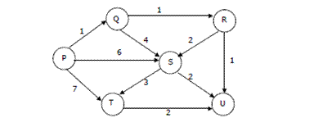
Q. Dijkstra’s Algorithm (Source Node P, Directed Graph)
Visit order:
Node | SD | PN
P | 0
Q
R
S
T
U

Slide 21
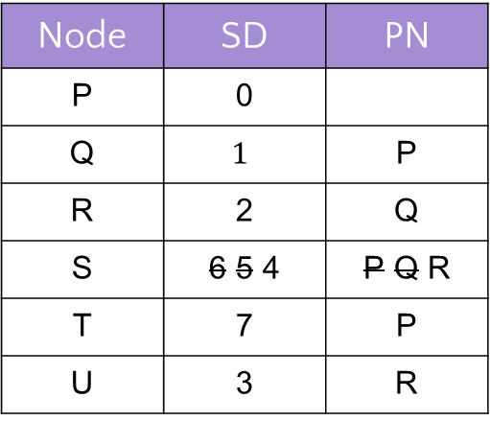
Q. Dijkstra’s Algorithm (Source Node P, Directed Graph) ANS
Visit order: P, Q, R, U, S, T
Node | SD | PN
P | 0
Q | $$1$$ | P
R | 2 | Q
S | 6 5 4 | P Q R
T | 7 | P
U | 3 | R

Slide 22
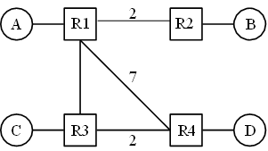
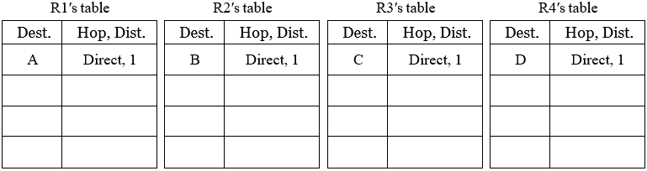
Q. Distance-Vector
Consider running the distance-vector protocol on the topology below. Unlabeled links have cost 1. Fill in the routing tables based on Distance-Vector algorithm. (refer to the handout for details.)

